Slide 1
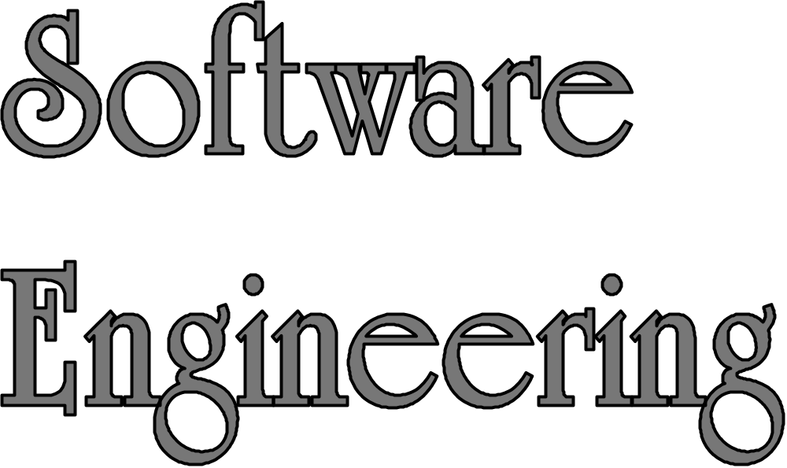
LECTURE 2: The Object Model
Shi Wenxuan
Nankai University

Slide 2
Topics
Objects and Method Calls
Interfaces
UML Notation
Object Relationships
Process/Algorithm –Oriented vs. Object Oriented Approaches

Slide 3
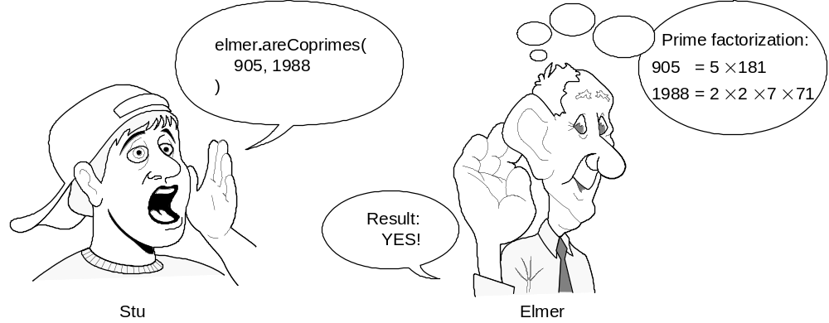
Objects, Calling & Answering Calls
Prime factorization of 905:
5×181 (2 distinct factors)
Prime factorization of 1988:
2×2×7×71 (4 factors, 3 distinct)
Two integers are said to be coprime or relatively prime if they have no common factor other than 1 or, equivalently, if their greatest common divisor is 1.
Notes:
http://www.wolframalpha.com/

Slide 4
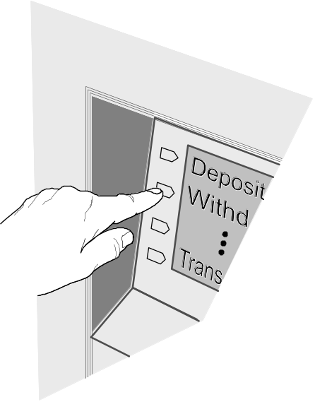
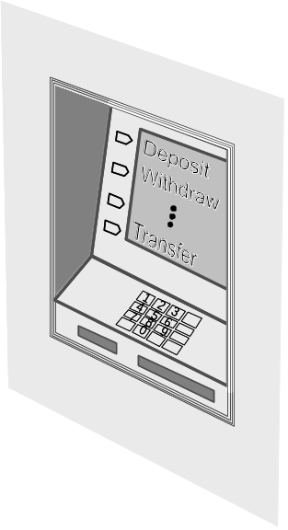
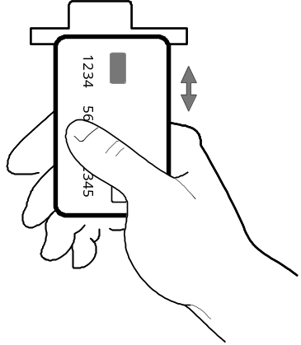
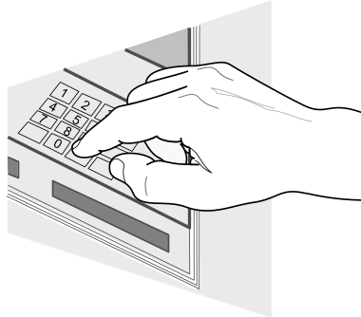
Objects Don’t Accept Arbitrary Calls
Acceptable calls are defined by object “methods”
(a.k.a. Operations, Procedures, Subroutines, Functions)
Object:
ATM machine
method-1:
Accept card
method-2:
Read code
method-3:
Take selection

Slide 5
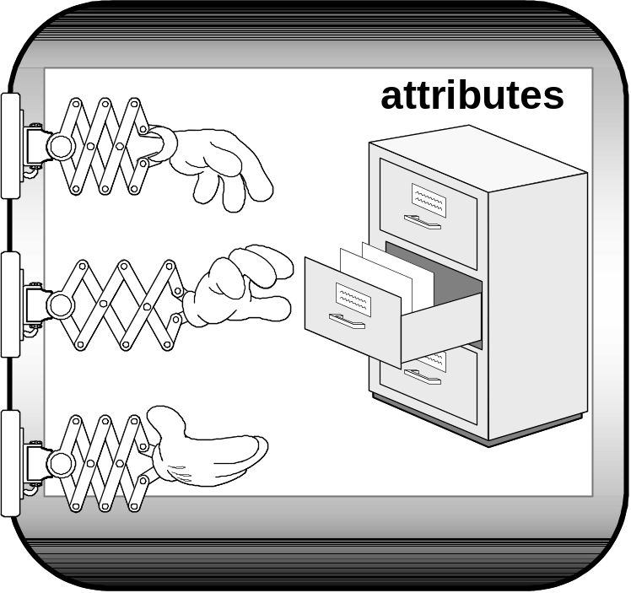
Object Interface
Interface defines method “signatures”
Method signature: name, parameters, parameter types, return type
Interface
method-1
Object hides its state (attributes). The attributes are accessible only through the interface.
method-2
method-3

Slide 6
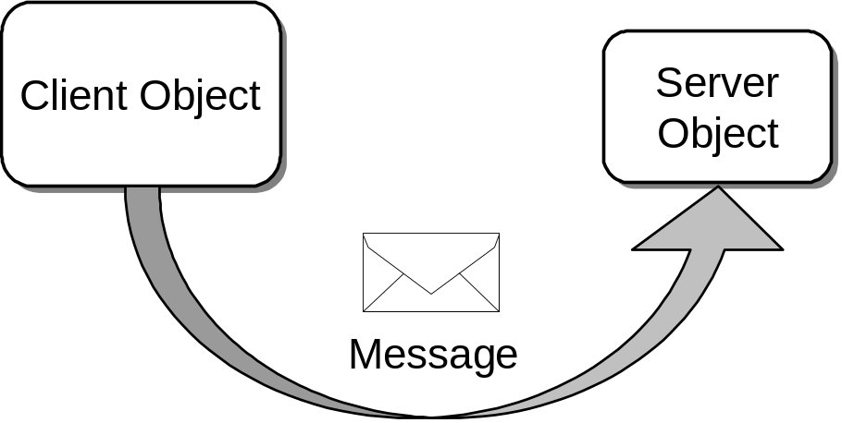
Clients, Servers, Messages
Objects send messages by calling methods
Client object: sends message and asks for service
Server object: provides service” and returns result

Slide 7
Interfaces
An interface is a set of functional properties (services) that a software object provides or requires.
Methods define the “services” the server object implementing the interface will offer
The methods (services) should be created and named based on the needs of client objects that will use the services
    “On-demand” design—we “pull” interfaces and their implementations into existence from the needs of the client, rather than “pushing” out the features that we think a class should provide

Slide 8
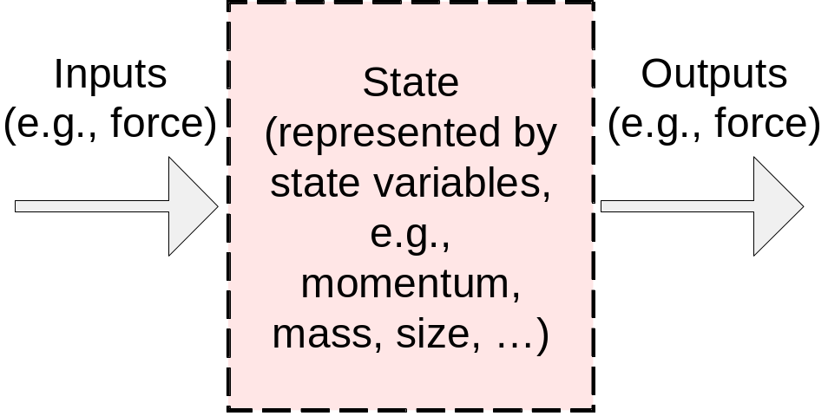
Objects are Modules
Software Module

Slide 9
Modules versus Objects
Modules are loose groupings of subprograms and data
“Promiscuous” access to data often results in misuse
Subprograms
(behavior)
Data
(state)
Software Module 1
Software Module 2
Software Module 3
Objects encapsulate data
Attributes
/data
(state)
Methods
(behavior)
Software Object 1
Software Object 2
Software Object 3

Slide 10
UML Notation for Classes
Software Interface Implementation
Software Class
«interface»
BaseInterface
+ operation()
Inheritance
relationship:
BaseInterface
is implemented
by two classes
ClassName
# attribute_1 : int
# attribute_2 : boolean
# attribute_3 : String
+ operation_1() : void
+ operation_2() : String
+ operation_3(arg1 : int)
Three compartments:
Classifier name
Attributes
Operations
Class1Implement
+ operation()
Class2Implement
+ operation()

Slide 11
Object Relationships (1)
Composition: using instance variables that are references to other objects
Inheritance: inheriting common properties through class extension
Base Class A
+ operation()
Derived Class B
+ operation()
Base Class A
+ operation()
Composition
Derived Class B
+ operation()
B acts as “front-end” for A and uses services of A
(i.e., B may implement the same interface as A)
Inheritance

Slide 12
Object Relationships (2)
Both inheritance and composition extend the base functionality provided by another object
INHERITANCE: Change in the “base” class propagates to the derived class and its client classes
  BUT, any code change has a risk of unintentional introducing of bugs.
COMPOSITION: More adaptive to change, because change in the “base” class is easily “contained” and hidden from the clients of the front-end class

Slide 13
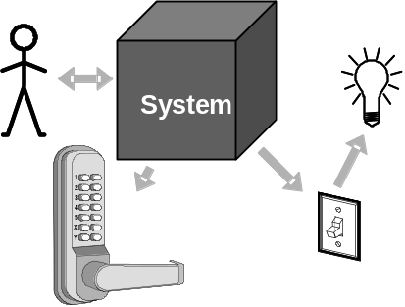
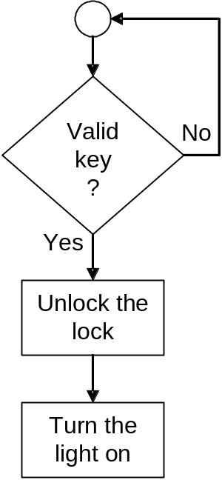
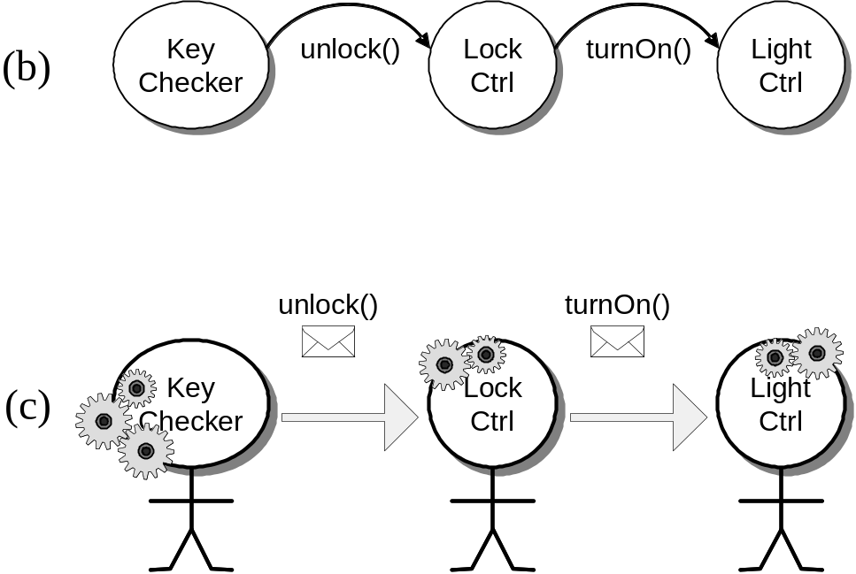
Object-Oriented versus
Process-Oriented Approaches
(a)
Process oriented
Object oriented

Slide 14
Object vs. Process-Oriented (1)
Process-oriented is more intuitive because it is person-centric
  thinking what to do next, which way to go
Object-oriented may be more confusing because of labor-division
  Thinking how to break-up the problem into tasks, assign responsibilities, and coordinate the work
  It’s a management problem…

Slide 15
Object vs. Process-Oriented (2)
Process-oriented does not scale to complex, large-size problems
  Individual-centric, but…
Large scale problems require organization of people instead of individuals working alone
Object-oriented is organization-centric
  But, hard to design well organizations…

Slide 16
How To Design Well OO Systems?
That’s the key topic of this course!
Decisive Methodological Factors:
  Traceability
  Testing
  Measurement
  Security

Slide 17
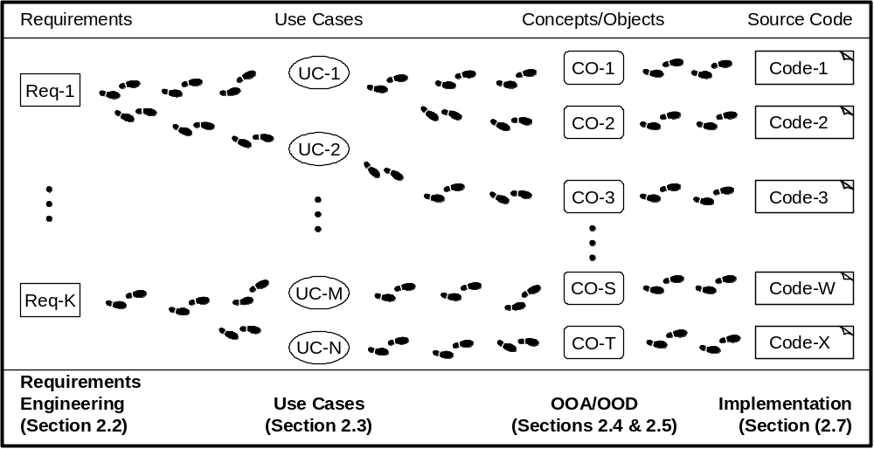
Traceability (1)
It should be possible to trace the evolution of the system, step-by-step, from individual requirements, through design objects, to code blocks.

Slide 18
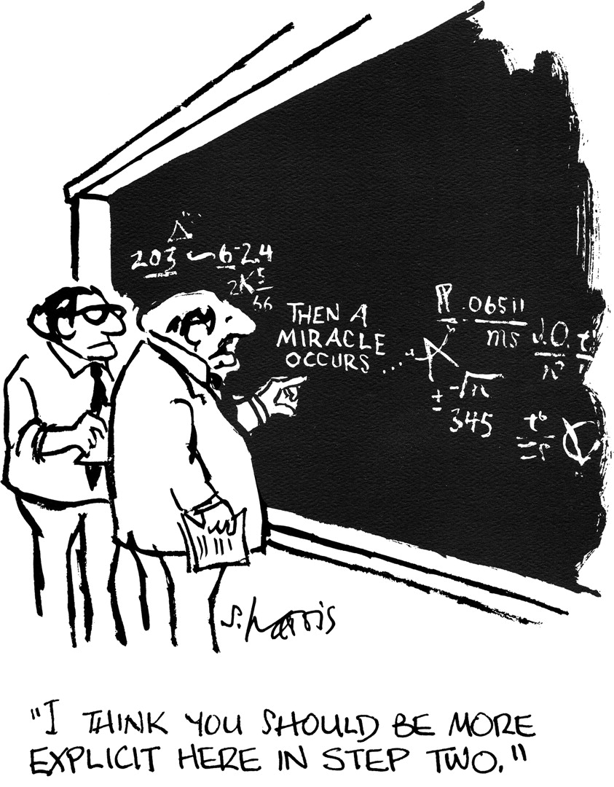
Traceability (2)
Avoid inexplicable leaps!
…where did this come from?!
“Deus ex machina”
Notes:
http://www.theatlantic.com/past/docs/issues/99may/9905billout.htm
http://en.wikipedia.org/wiki/Deus_ex_machina
http://en.wikipedia.org/wiki/Plot_device [A plot device]

Slide 19
Testing (1)
Test-Driven Development (TDD)
Every step in the development process must start with a plan of how to verify that the result meets a goal
The developer should not create a software artifact (a system requirement, a UML diagram, or source code) unless they know how it will be tested
But, testing is not enough…

Slide 20
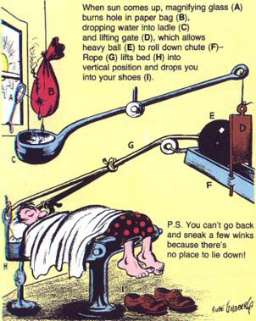
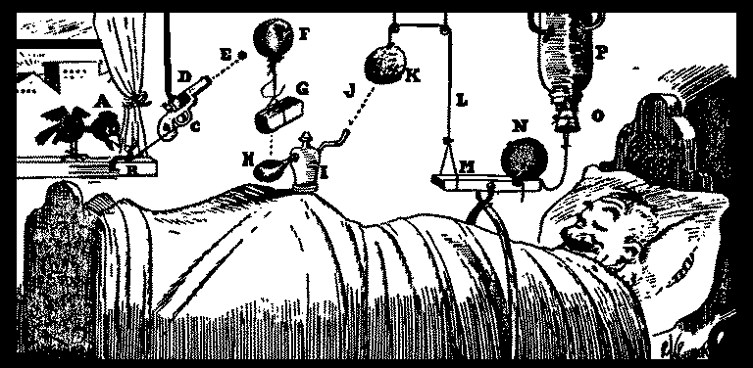
Testing (2)
A Rube Goldberg machine follows
Test-Driven Development (TDD)
—the test case is always described
…it’s fragile—works correctly for one scenario
Automatic alarm clock
Oversleeping cure

Slide 21
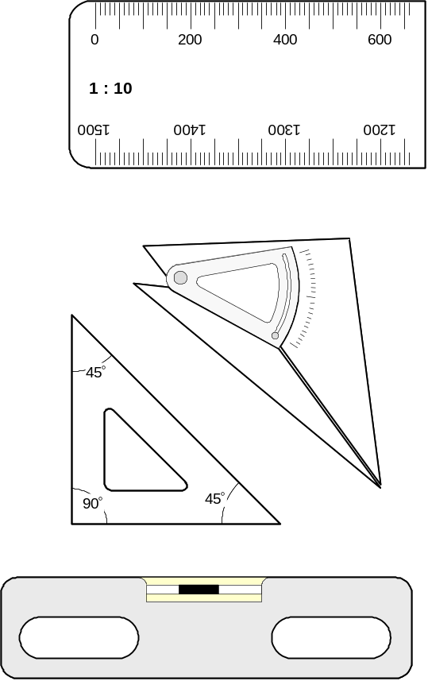
Measuring (1)
We need tools to monitor
the product quality
And tools to monitor the
developers productivity
But, measuring is not enough…

Slide 22
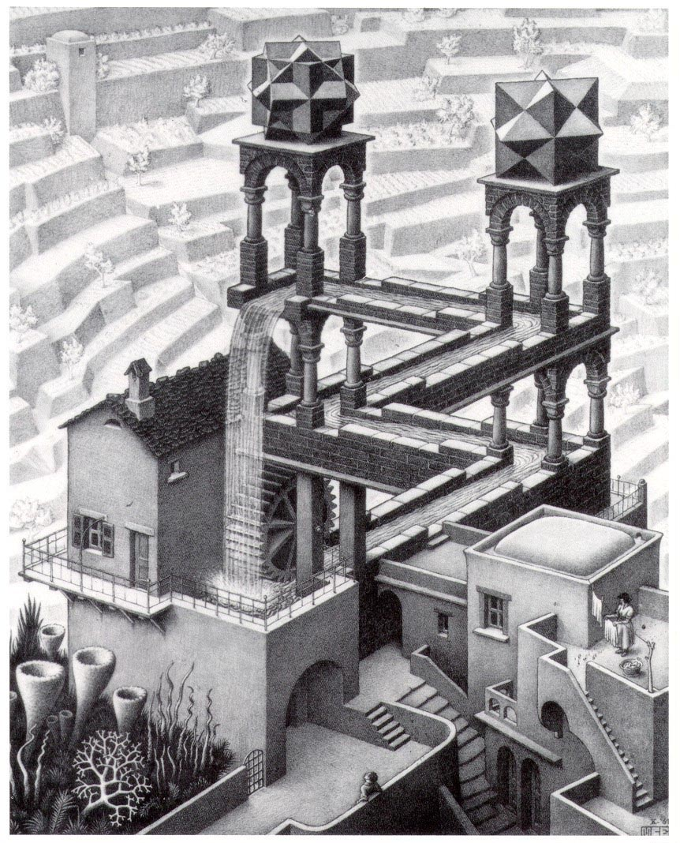
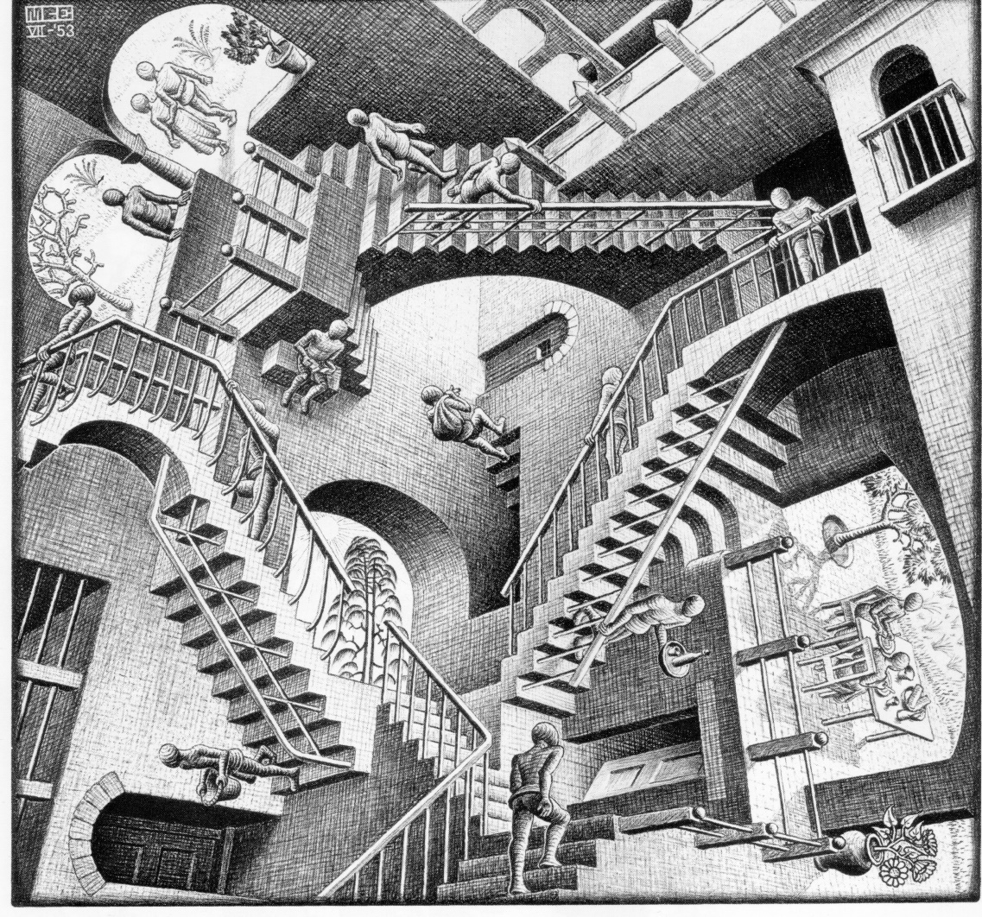
Measuring (2)
Maurits Escher designs, work under all scenarios (incorrectly)
—robust but impossible
Relativity
Waterfall

Slide 23
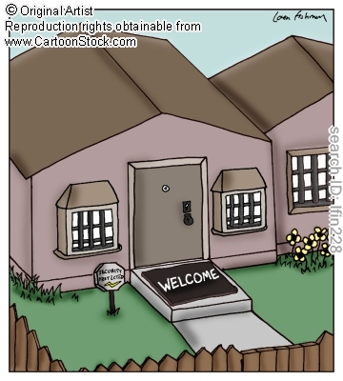
Security
Conflicting needs
of computer security…
Microsoft Security Development Lifecycle (SDL)
The Security Development Lifecycle (SDL) is a software development process that helps developers build more secure software and address security compliance requirements while reducing development cost
Notes:
http://en.wikipedia.org/wiki/Microsoft_Security_Development_Lifecycle

